Slide 1
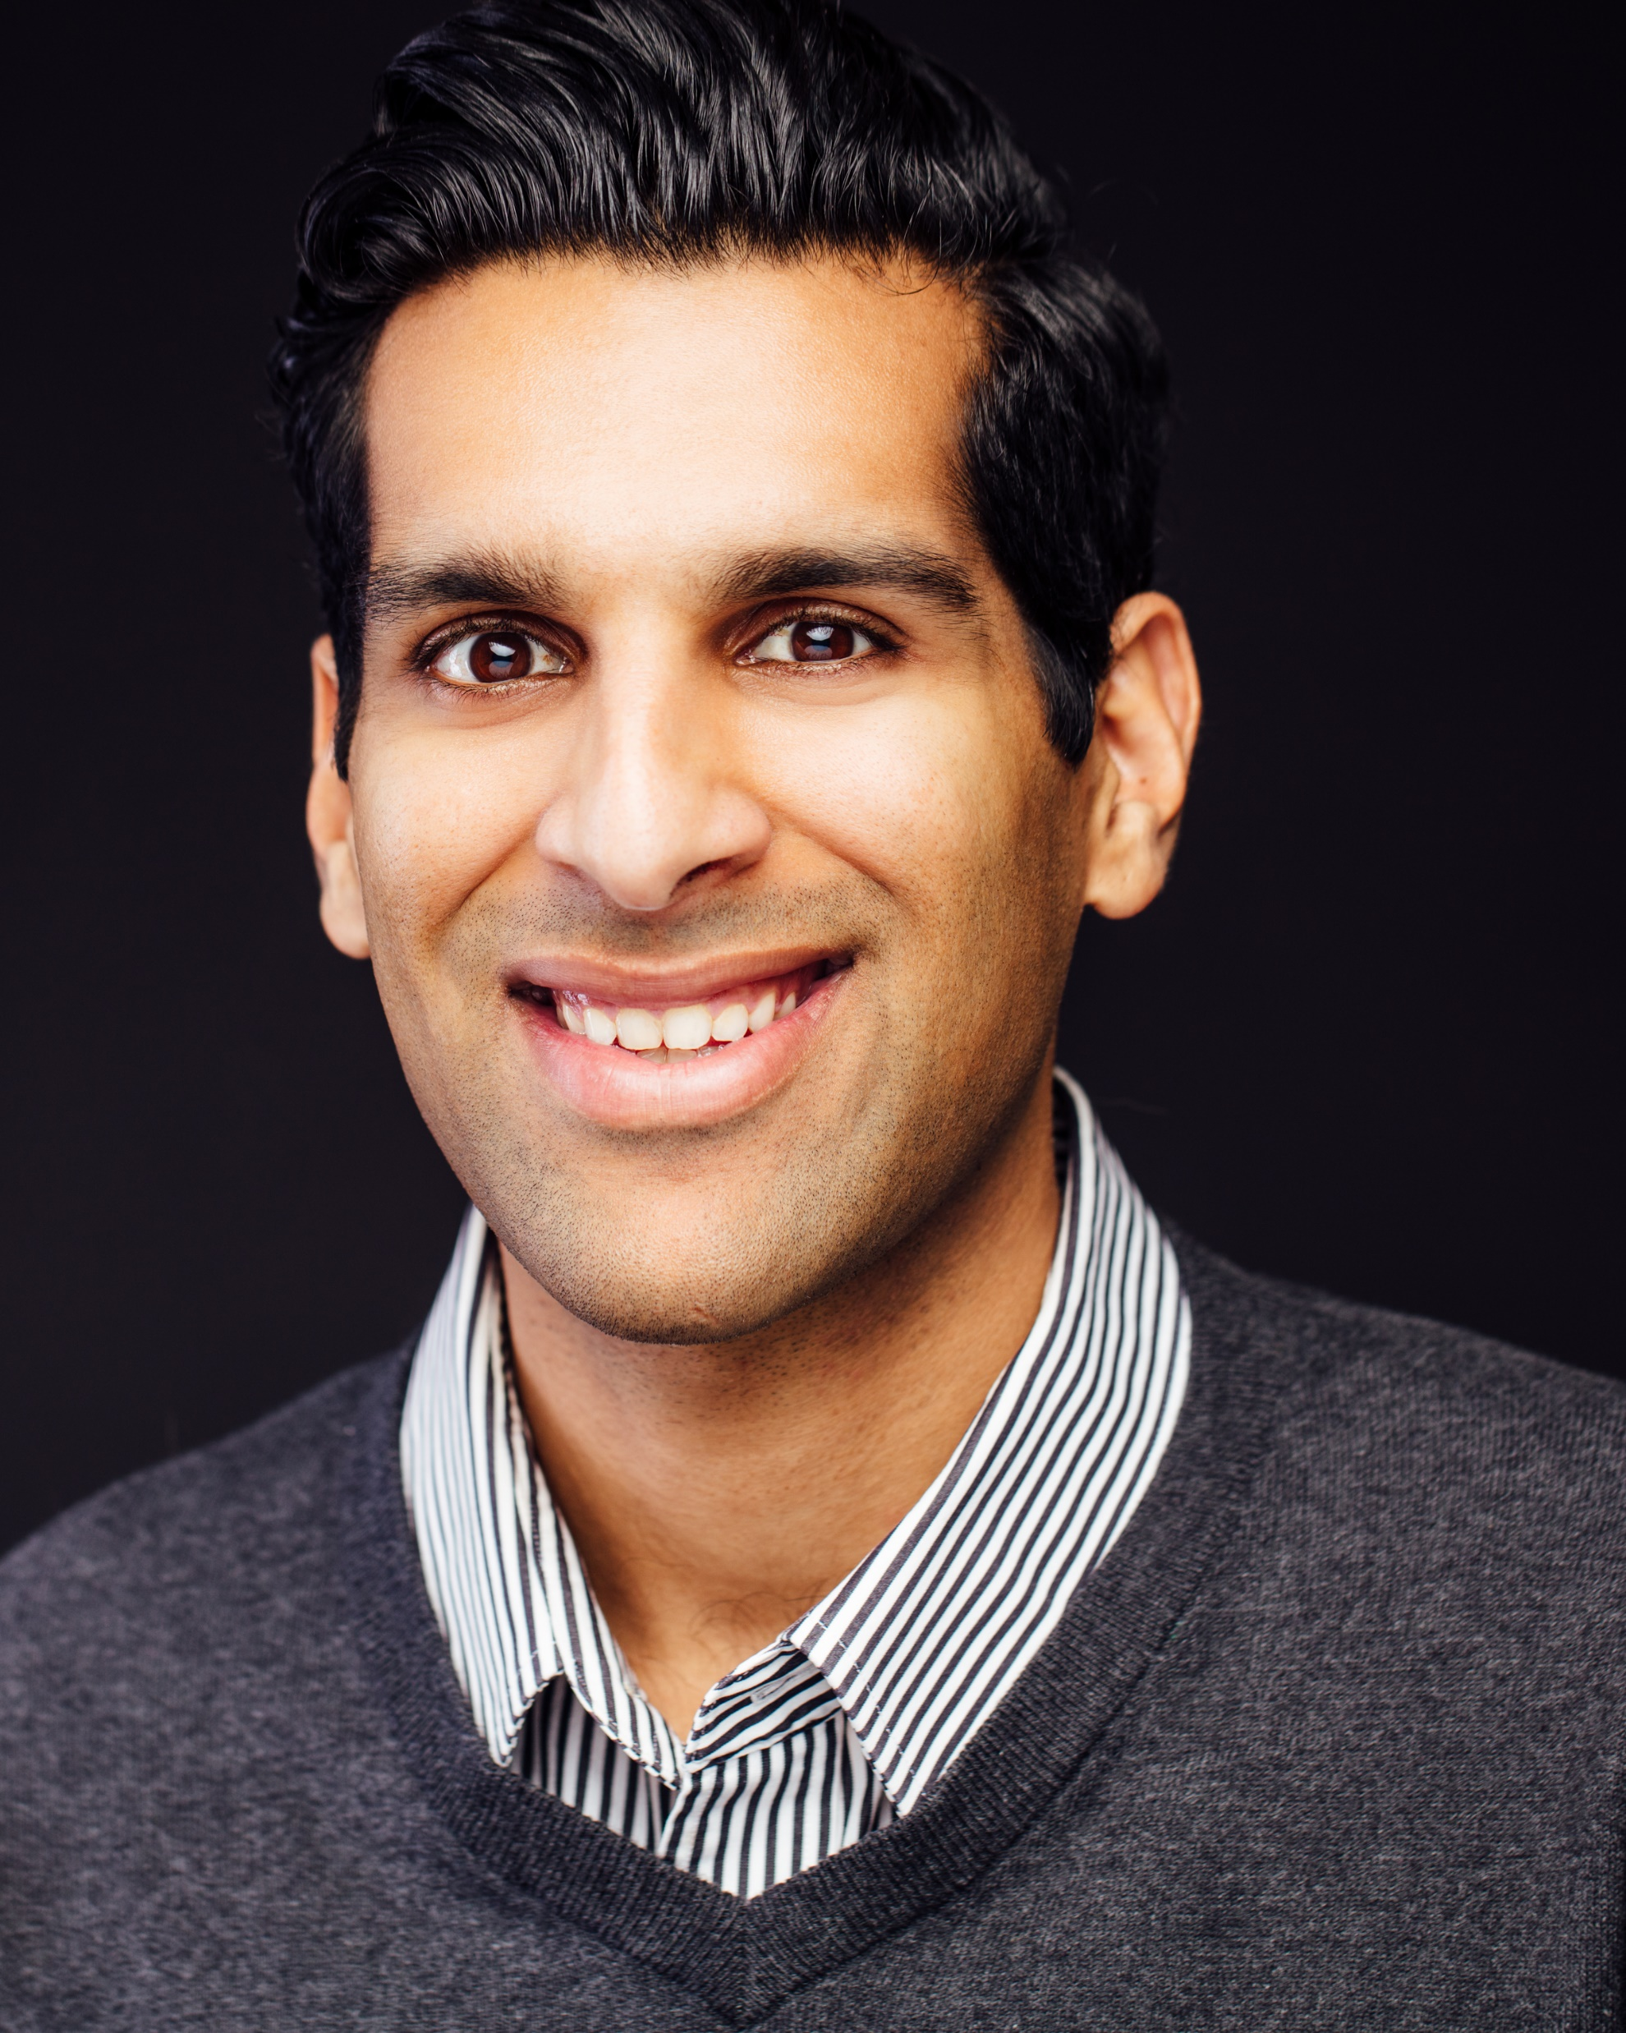
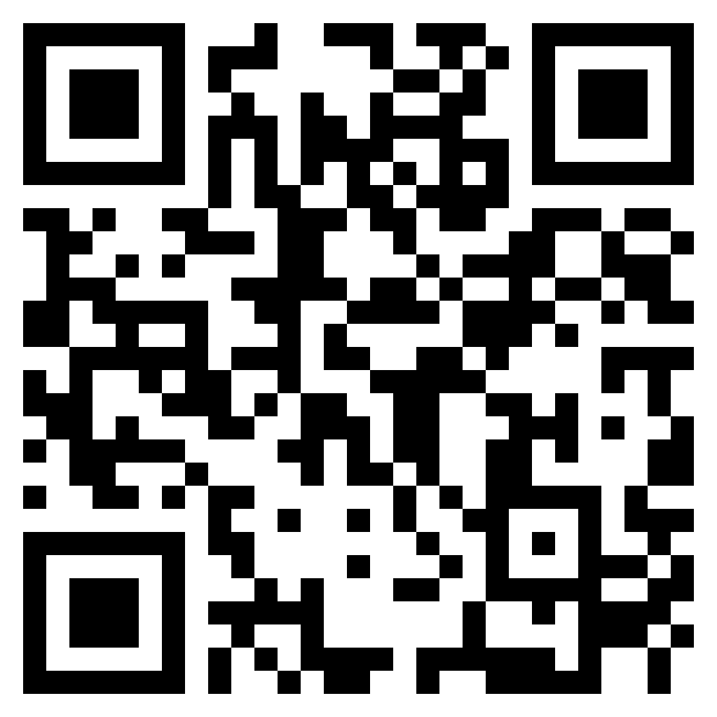
Omar Abdullah, Ph.D. Director of Business Development, Guardian Computer
Sales Coach, AchieveNEXT
Omar is a business development professional, interdisciplinary scholar, and former comedian (key word being former) located in Austin, TX. He consults with healthcare, information technology, and manufacturing organizations. Helping businesses grow sustainably. Omar has taught courses at the University of California, Davis, and Texas A&M University, as well as speaking at conferences and facilitating workshops at Trinity University, Georgetown University, and SXSW.

